Slide 1
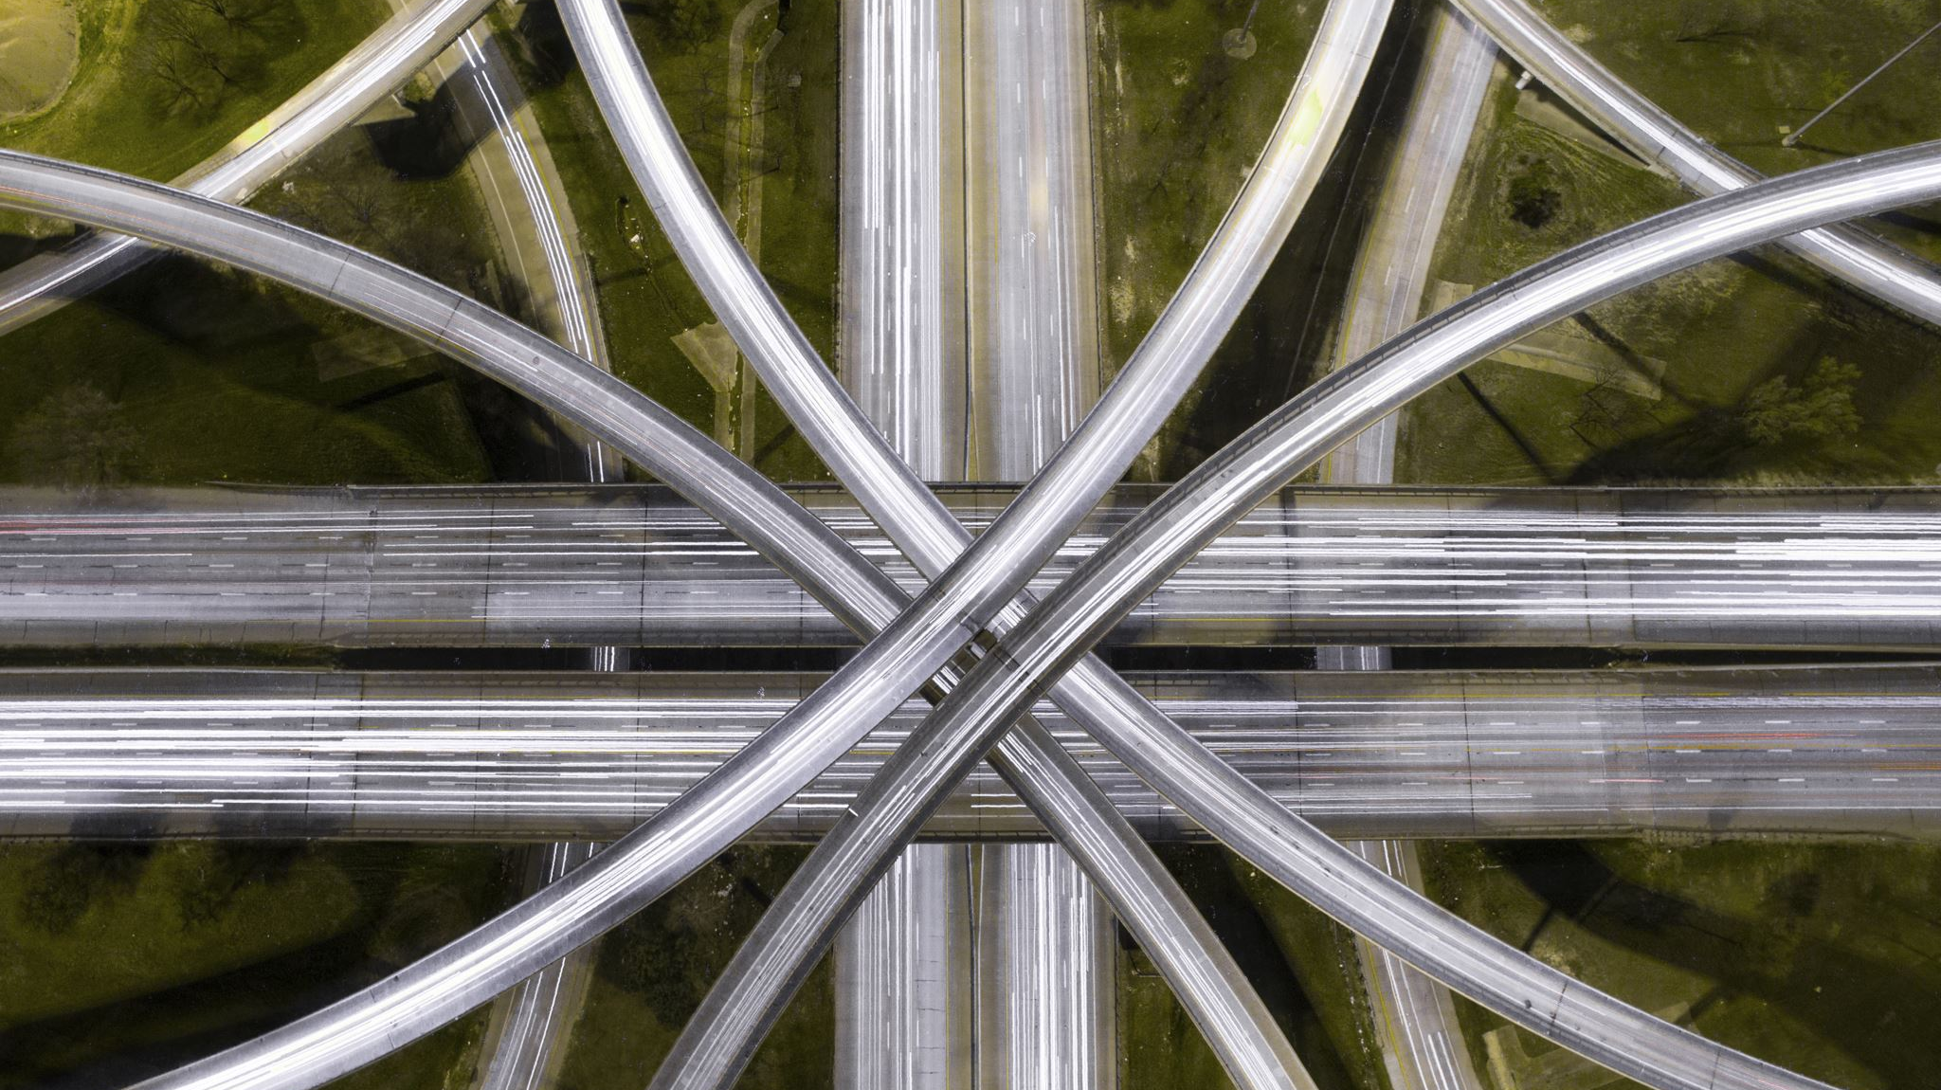
Intersection of Two Arrays
Eunice Njeri
Charity Kimani
Lesley Bonyo

Slide 2
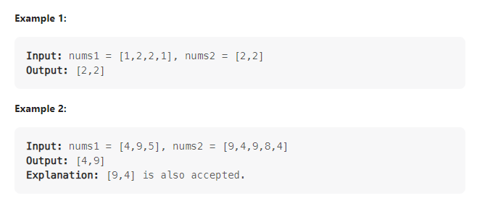
Problem
Given two integer arrays nums1 and nums2, return an array of their intersection. Each element in the result must appear as many times as it shows in both arrays and you may return the result in any order.

Slide 3
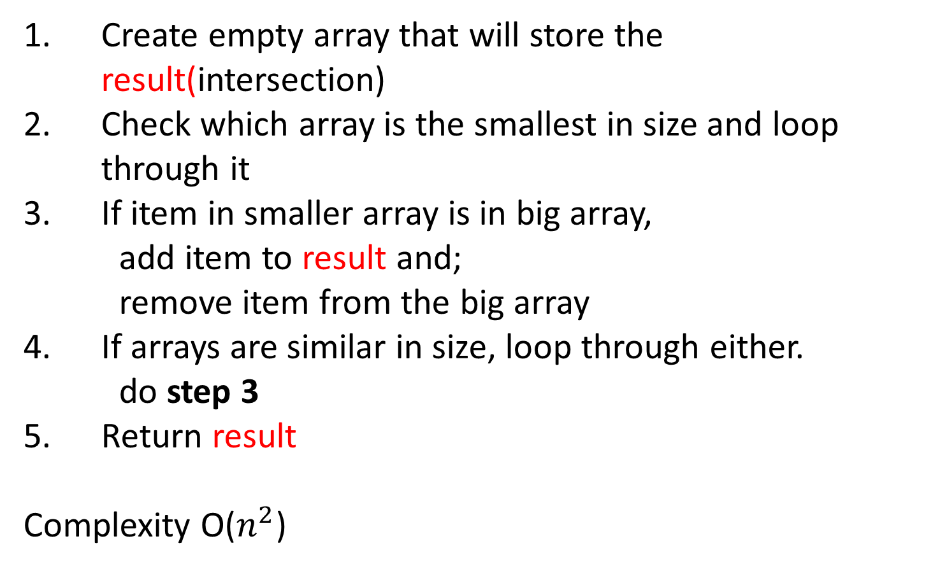
Solution
Create empty array that will store the result(intersection)
Check which array is the smallest in size and loop through it
If item in smaller array is in big array,
add item to result and;
remove item from the big array
If arrays are similar in size, loop through either.
do step 3
Return result
Complexity O($n^{2}$)

Slide 4
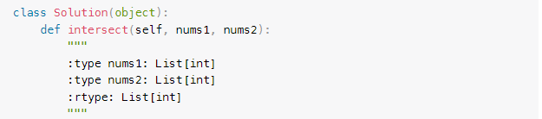
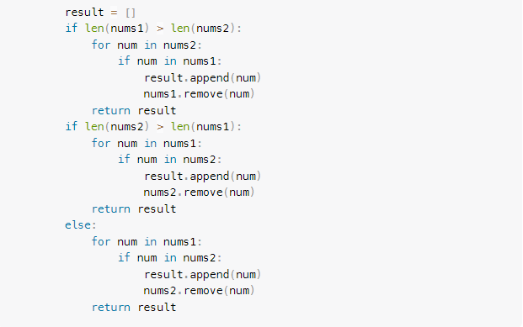
Code

Slide 5

Questions? The End

